Slide 1

Bootstrap part 1
Let’s know more about Bootstrap Framework
Prepared by Helena Natanael, for FWD by dibimbing.id

Slide 2
1
Bootstrap Introduction
2
Front End Layout: Viewport
3
Container and Grid
Outline
4
Media Query
5
Images

Slide 3
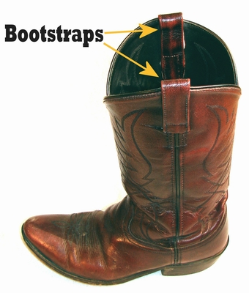

Bootstrap Introduction
What is the kind of Bootstrap that we will learn?
A. B.
1 of 17

Slide 4
Let’s know more about Bootstrap
Originally built by the developers of Twitter, Marc Otto and Jacob Thornton to encourage consistency among internal tools, on 2010.
Also known as “Twitter Blueprint”
Widely used because it makes us easy to build a responsive website (can be used in desktop and mobile browsers) using HTML, CSS / Sass, JS.
2 of 17

Slide 5
Let’s know more about Bootstrap
It’s an open-source framework, means it’s free!
We can also contribute to the source code (https://github.com/twbs/bootstrap)
The latest stable version is version 5.2.3
3 of 17

Slide 6
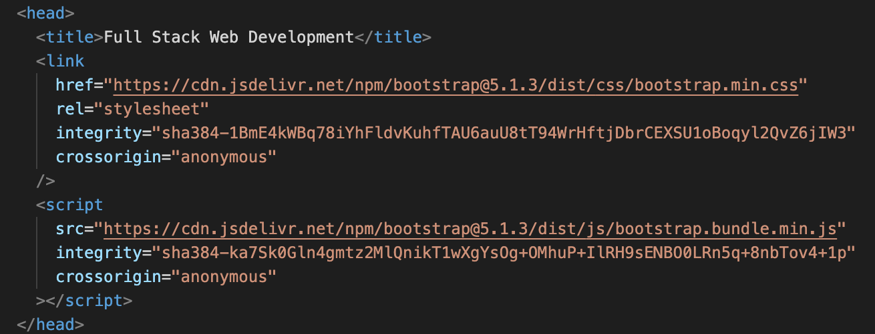
Importing Bootstrap
https://getbootstrap.com/docs/5.2/getting-started/download/
4 of 17

Slide 7
Front End Layout:
Viewport
5 of 17

Slide 8
Viewport is the user’s visible area of web page. It’s varies among devices, will be smaller on mobile browser than on desktop.
Viewport is invented after we started using tablets and mobile phones and needed a responsive websites.
It’s put in the head tag of a HTML.
We can check our viewports using these queries:
document.documentElement.[clientWidth | clientHeight]
window.[innerWidth | innerHeight] → only the viewport pixels
window.[outerWidth | outerHeight] → the viewport + browser window pixels
6 of 17
Notes:
Additional References:
https://css-tricks.com/snippets/html/responsive-meta-tag/

Slide 9
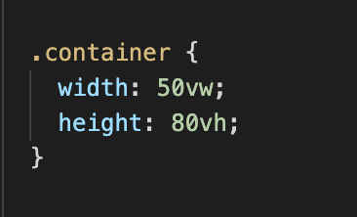
For responsive websites, usually the elements are using vh (viewport height) and vw (viewport width) instead of using pixels for their heights and widths.
Let’s jump into hands-on to understand more!
7 of 17
Notes:
Additional References:
https://css-tricks.com/snippets/html/responsive-meta-tag/
https://caniuse.com/?search=vw

Slide 10
Container and Grid
8 of 17

Slide 11
What is Container?
‘Container’ is a convention used by programmers to describe an element (usually a div) that will contain all the other elements in a website.
In Bootstrap, container is a required component that must be used in each page if you want to use Bootstrap’s default grid system.
Containers can be nested, but in most cases you will not need it.
9 of 17

Slide 12
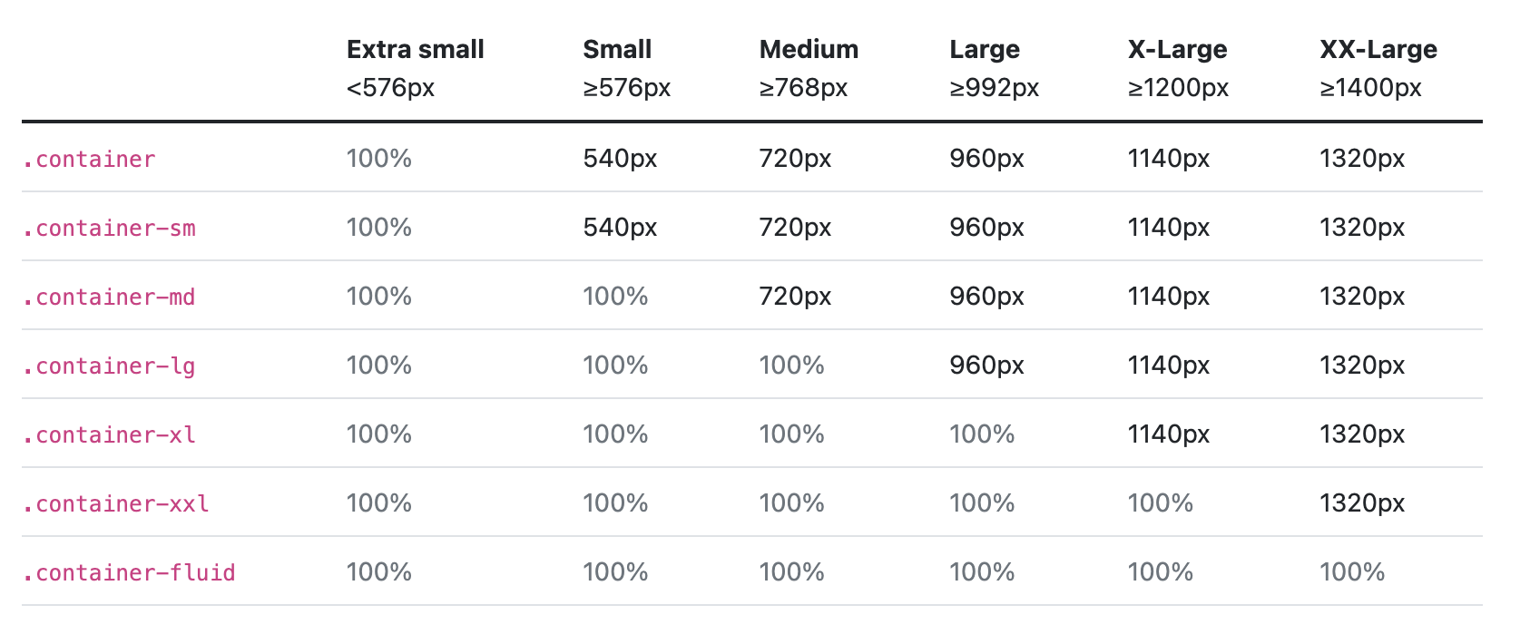
Container class types in Bootstrap:
.container
.container-fluid
.container-[sm | md | lg | xl | xxl]
https://getbootstrap.com/docs/5.1/examples/grid/#containers
10 of 17

Slide 13
What is Grid?
‘Grid’ in the graphic design (part of front end dev), is a structure (mostly 2 dimensional), made up of a series of intersecting lines (horizontal, vertical) used to structure a content. It’s used as a guideline for how elements should be positioned within a layout.
Similar with Containers, Grid can also be nested, but in most cases you will not need it.
Bootstrap’s grid system is built using CSS flexbox.
11 of 17
Notes:
References: https://en.wikipedia.org/wiki/Grid_(graphic_design)
https://www.creativebloq.com/web-design/grid-theory-41411345

Slide 14
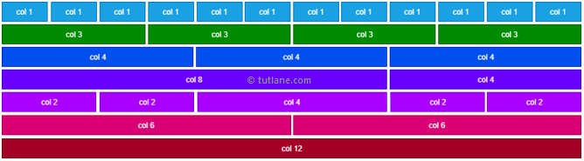
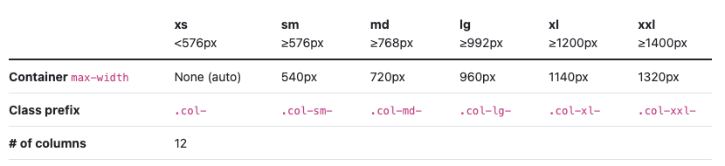
Grid class types in Bootstrap:
.[row | col]
.[row | col]-[sm | md | lg | xl | xxl]-[auto | 1-12]
https://getbootstrap.com/docs/5.1/examples/grid/
12 of 17

Slide 15
Ice Breaking

Slide 16
Media Query
13 of 17

Slide 17
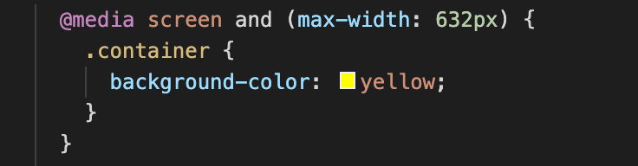
It’s first introduced in CSS 3, to cater the needs of responsive websites.
The CSS Syntax about media query will look like this:
Let’s try together in our VS Code!
14 of 17

Slide 18
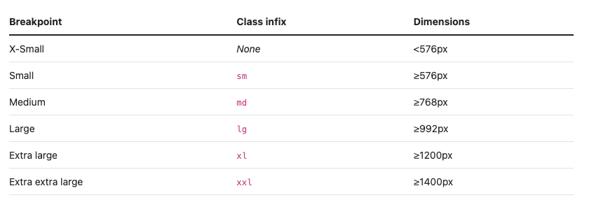
Usage in Bootstrap
Bootstrap’s responsiveness is also built up by the usage of media queries, it has six default breakpoints ready to use across the columns and rows.
15 of 17

Slide 19
Images
16 of 17

Slide 20

Bootstrap made it easy to style images based on their predefined classes.
By using the class .img-fluid, we already make the image responsive based on screen width.
Based on this docs (https://getbootstrap.com/docs/5.1/content/images/), there are some other classes to style images in Bootstrap:
.img-thumbnail
.rounded
17 of 17

Slide 21
Thank you
That’s all for this session!
References: https://developer.mozilla.org/en-US/docs/Web/CSS/Viewport_concepts
https://getbootstrap.com/docs/5.1/layout/grid/
https://www.tutlane.com/tutorial/bootstrap/bootstrap-grid-system
https://www.w3schools.com/css/css_rwd_mediaqueries.asp
https://stackoverflow.com/questions/8549529/what-is-the-difference-between-screen-and-only-screen-in-media-queries
Prepared by Helena Natanael, for FWD by dibimbing.id

